Slide 1
Project Report on
airplane crashes and fatalities
BY
Shibasis Karmakar
Internship Program
Under the Guidance of:
Mentorness

Slide 2
Declaration
I, Shibasis Karmakar, a working professional , have completed my Graduation from Calcutta University in 2010 on B.com(h). The Project Report on Analysis of Airplane crashes and fatalities
spanning from 1908 to 2023. in fulfilment of Internship program from Mentorness is the original work conducted by me.
The information and data given in the report is authentic to the best of my knowledge. This report has not been submitted to any other university for the award of any other degree, diploma and fellowship.
Shibasis Karmakar
Place: West Bengal(Kolkata)
Date of submission: 30/04/2024

Slide 3
Project title
Data Sources
Data Sets
Tool Used
Dataset includes table of Details : Airplane Crashes
Rows Columns
4998 19
Software: Excel, Tableau Public
Hardware: AMD Ryzen 3 2200G with Radeon Vega Graphics 3.50 GHz
Ram:8.00 GB.
Edition: Windows 10 pro
Provided by Mentorness
Internship Project
Via Email.

Slide 4
Introduction on Airplane Crashes
This internship project focuses on conducting a comprehensive analysis of airplane crashes and fatalities spanning from 1908 to 2023.
The dataset contains crucial information such as crash dates, locations, operators, flight details, aircraft types, and fatality statistics. The goal is to leverage Tableau for interactive visualizations and in-depth insights to understand patterns, contributing factors, and trends in aviation incidents.
The analysis aims to provide stakeholders with valuable information for enhancing aviation safety and mitigating risks.

Slide 5
Brief Description on Dataset
1. Date: Date of the airplane crash.
2. Time: Time of the airplane crash.
3. Location: Location where the airplane crash occurred.
4. Operator: Operator or airline involved in the incident.
5. Flight #: Flight number associated with the incident.
6. Route: Planned route of the flight.
7. AC Type: Aircraft type involved in the crash.
8. Registration: Registration details of the aircraft.
9. Cn/ln: Construction or serial number of the aircraft.
10. Aboard: Total number of individuals aboard the aircraft.
11. Aboard Passengers: Number of passengers aboard the aircraft.
12. Aboard Crew: Number of crew members aboard the aircraft.
13. Fatalities: Total fatalities in the incident.
14. Fatalities Passengers: Number of passenger fatalities.
15. Fatalities Crew: Number of crew member fatalities.
16. Ground: Casualties on the ground, if any.
17. Summary: Brief summary or description of the incident.

Slide 6
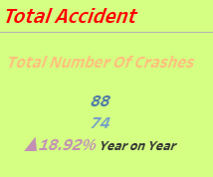
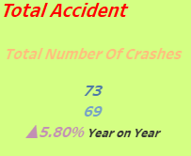
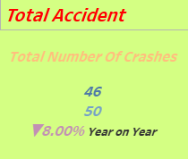
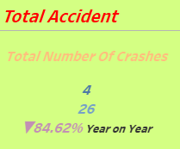
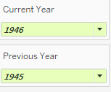
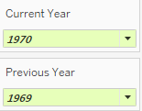
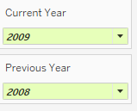
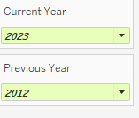
Total Accident Year by Year

Slide 7
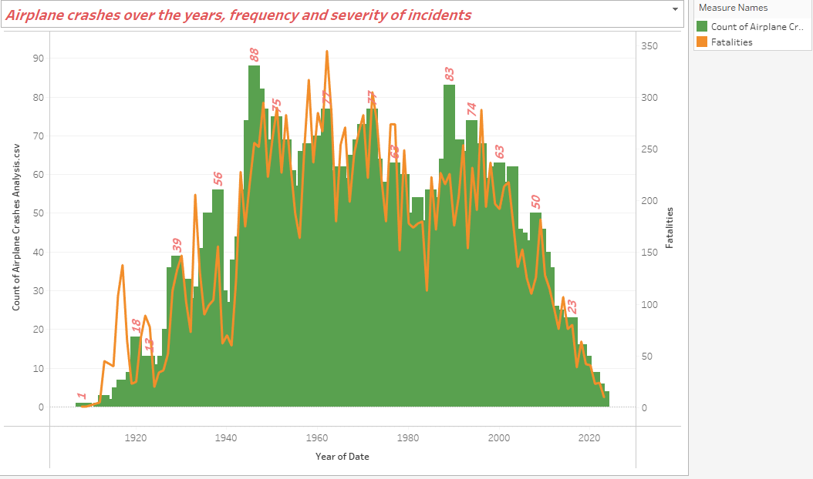
Temporal Analysis
As per the temporal analysis we can find that year on year basis the crashes of the Airplane get decreasing.
In the year 1946 we can see that the crashes number is 88 and it was constant till 2008 which is more than 50. After that it was drastically going down which is only 4 in 2003 due to the new & updated technologies in the Aviation Sector.

Slide 8
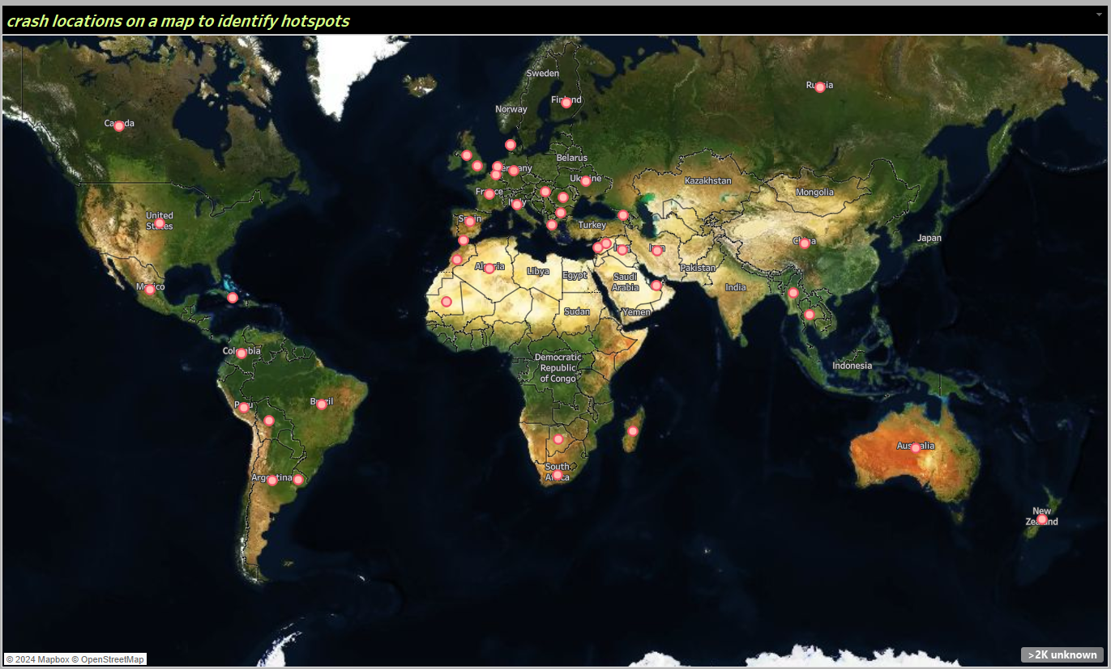
Geospatial Analysis
Across the location on the map we can clearly identify by hotspot in which area or different region the airplane Crashes occurs.

Slide 9
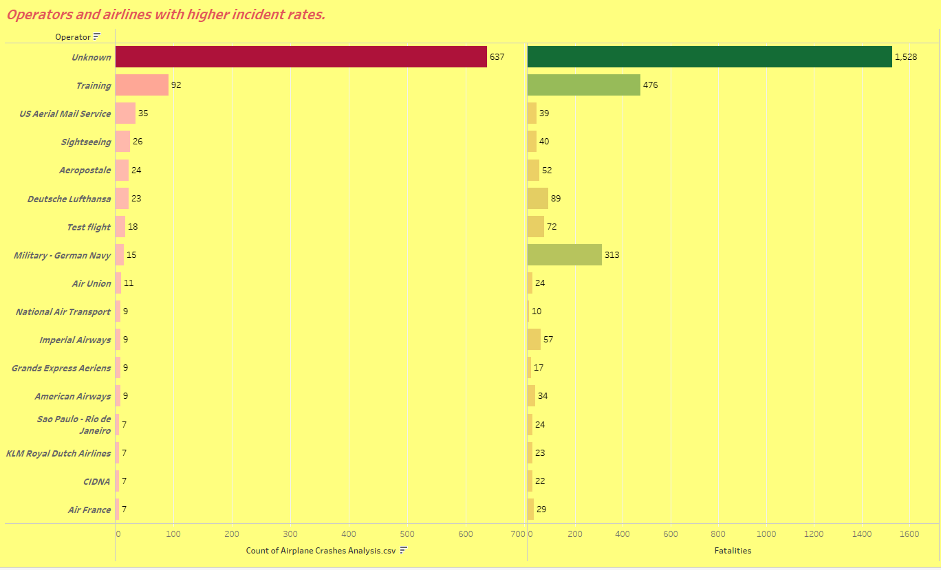
Operator Performance
We Can see the operators of the airlines has high incident rates.
In case of Training Operators both the Crashes & facilities are high.
Where as National Air transport & Air France has much lesser crashes & facilities.

Slide 10
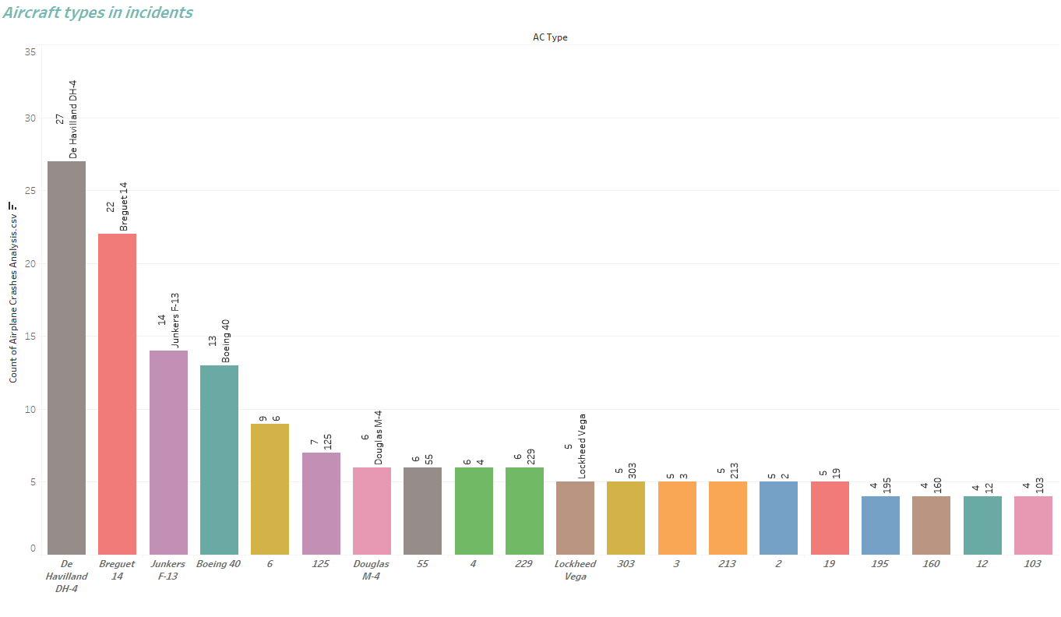
Aircraft Analysis
The data suggest the top Aircraft types incident involving in the Crashes.
Here we can see the Aircraft type “De Havilland DH-4” has the highest Crashes of 27 where as the least Aircraft type “103” has only four crashes.

Slide 11
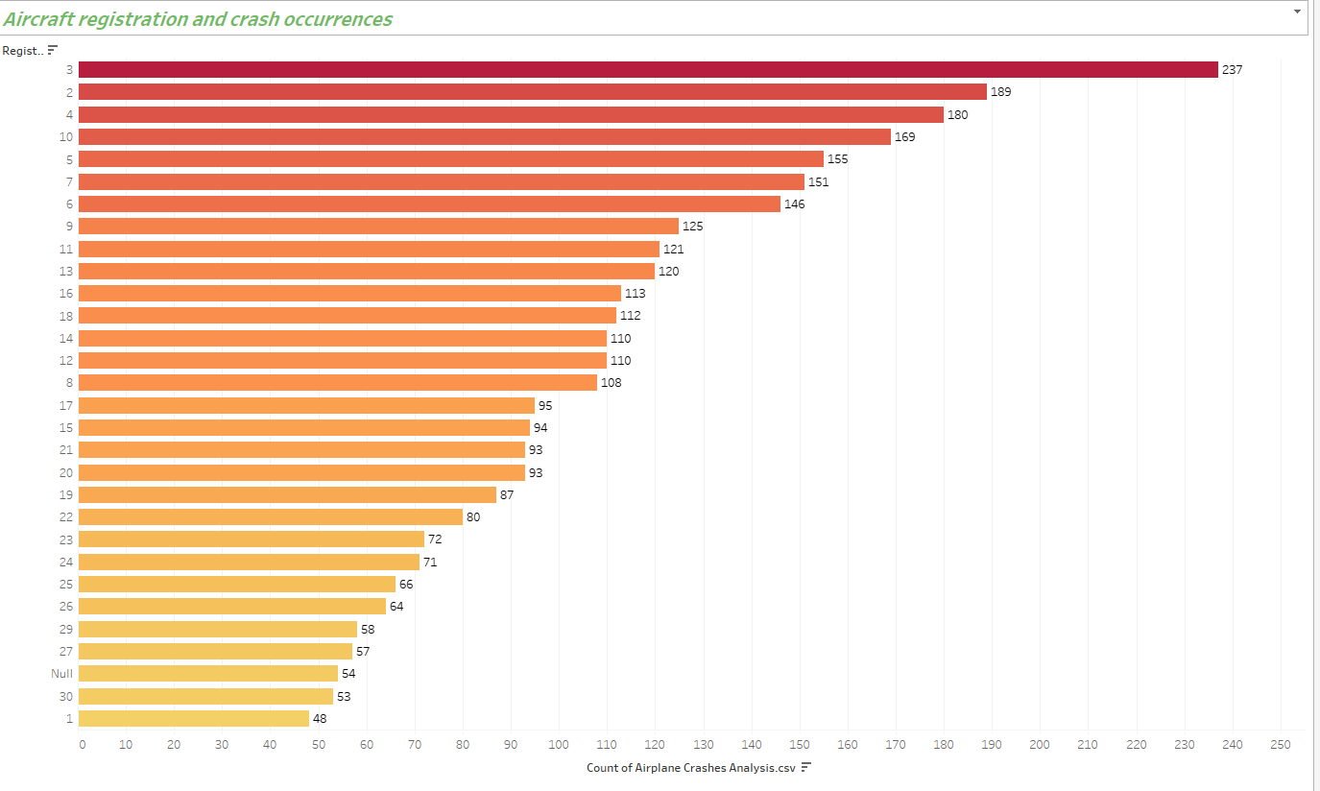
Aircraft Analysis
The Analysis indicates the relationship between aircraft registration and crash occurrences.

Slide 12
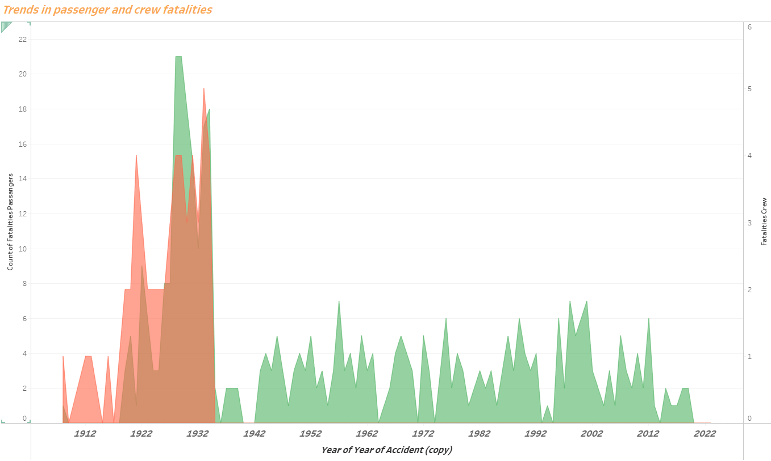
Fatality Trends
Here we can see two Area covering passenger and crew fatalities.
Data suggest that there was a declining trends in both the Area of passenger and crew fatalities.
It clearly shows that Aviation sector has work on it get out or rather we can say to reduce the Crashes.

Slide 13
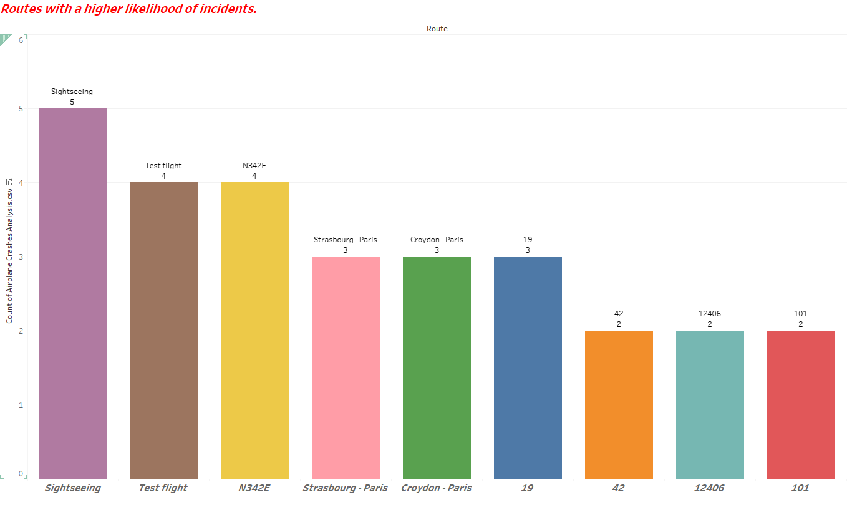
Route Analysis
As per the Visualization suggest the Route where most of the incident occurs.
Sightseeing, Test flight , N342E etc has the highest involvement in the Crashes.

Slide 14
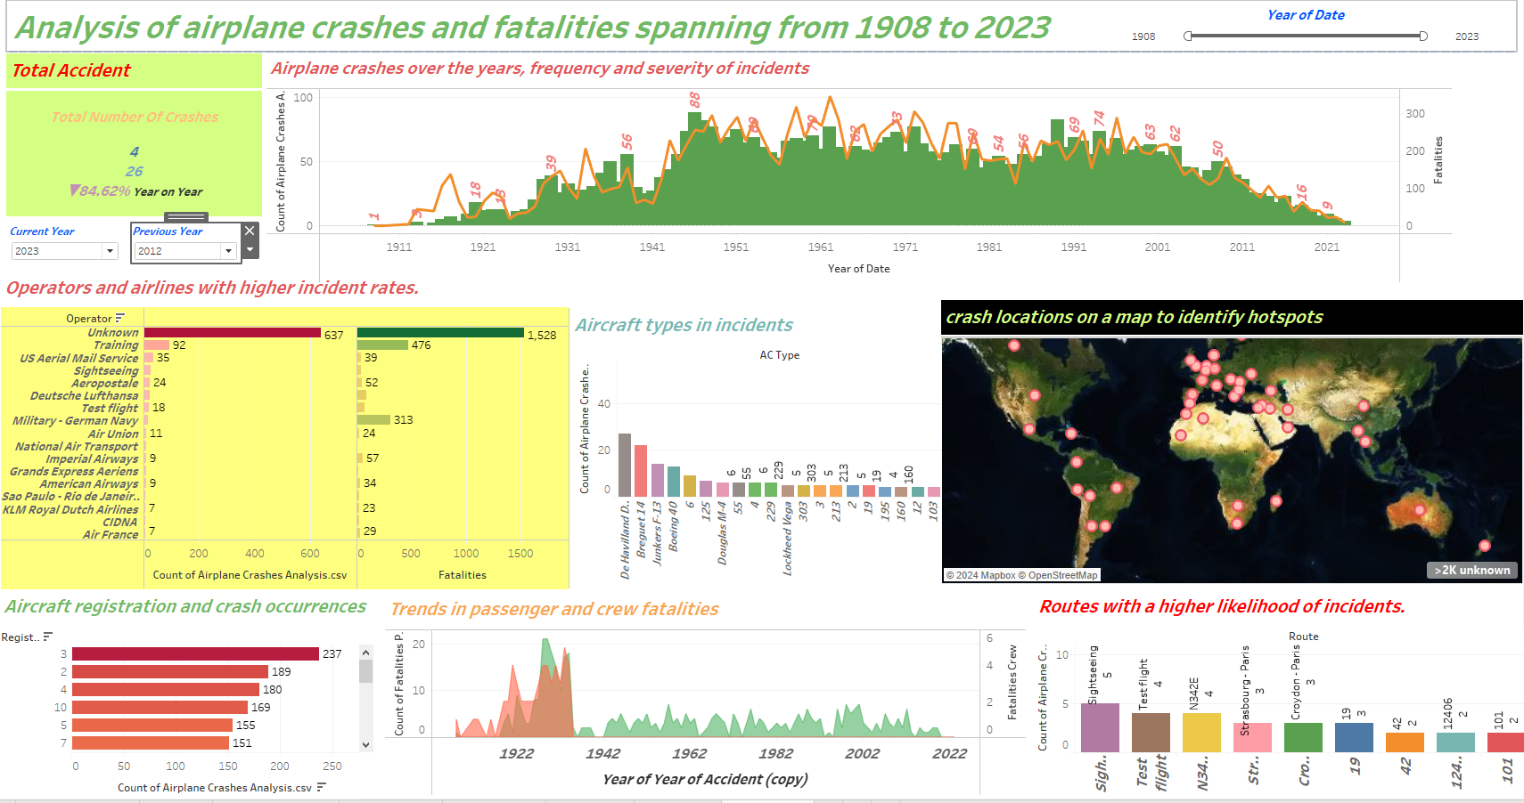
Dashboard

Slide 15
Thank you

